Slide 1
Lecture -31

Slide 2
String Matching Problem
Given: A text T and a pattern P
Goal: Finding all or one occurrences of a pattern P in given text T

Slide 3
String Matching Algorithm
T:
A | B | B | A | A | A | C | C | A | B | C | C | B | B | A
0 | 1 | 2 | 3 | 4 | 5 | 6 | 7 | 8 | 9 | 10 | 11 | 12 | 13 | 14
P:
A | B | C
0 | 1 | 2
Pattern P is present at index 8 in Text T

Slide 4
String Matching Problem
String Matching Algorithm
Naïve Algorithm
KMP algorithm

Slide 5
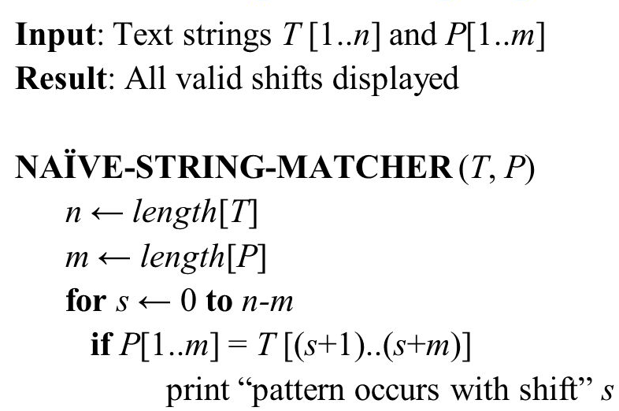
Naïve String Matching Algorithm

Slide 6
Naïve String Matching Algorithm
0 | 1 | 2 | 3 | 4 | 5 | 6 | 7 | 8 | 9 | 10 | 11 | 12 | 13 | 14
A | B | B | A | A | A | C | C | A | B | C | C | B | B | A
T:
P:
A | B | C
0 | 1 | 2

Slide 7
Naïve String Matching Algorithm
0 | 1 | 2 | 3 | 4 | 5 | 6 | 7 | 8 | 9 | 10 | 11 | 12 | 13 | 14
A | B | B | A | A | A | C | C | A | B | C | C | B | B | A
T:
P:
A | B | C
0 | 1 | 2

Slide 8
Naïve String Matching Algorithm
0 | 1 | 2 | 3 | 4 | 5 | 6 | 7 | 8 | 9 | 10 | 11 | 12 | 13 | 14
A | B | B | A | A | A | C | C | A | B | C | C | B | B | A
T:
P:
A | B | C
0 | 1 | 2

Slide 9
Naïve String Matching Algorithm
0 | 1 | 2 | 3 | 4 | 5 | 6 | 7 | 8 | 9 | 10 | 11 | 12 | 13 | 14
A | B | B | A | A | A | C | C | A | B | C | C | B | B | A
T:
P:
A | B | C
0 | 1 | 2

Slide 10
Naïve String Matching Algorithm
0 | 1 | 2 | 3 | 4 | 5 | 6 | 7 | 8 | 9 | 10 | 11 | 12 | 13 | 14
A | B | B | A | A | A | C | C | A | B | C | C | B | B | A
T:
P:
A | B | C
0 | 1 | 2

Slide 11
Naïve String Matching Algorithm
0 | 1 | 2 | 3 | 4 | 5 | 6 | 7 | 8 | 9 | 10 | 11 | 12 | 13 | 14
A | B | B | A | A | A | C | C | A | B | C | C | B | B | A
T:
P:
A | B | C
0 | 1 | 2

Slide 12
Naïve String Matching Algorithm
0 | 1 | 2 | 3 | 4 | 5 | 6 | 7 | 8 | 9 | 10 | 11 | 12 | 13 | 14
A | B | B | A | A | A | C | C | A | B | C | C | B | B | A
T:
P:
A | B | C
0 | 1 | 2

Slide 13
Naïve String Matching Algorithm
0 | 1 | 2 | 3 | 4 | 5 | 6 | 7 | 8 | 9 | 10 | 11 | 12 | 13 | 14
A | B | B | A | A | A | C | C | A | B | C | C | B | B | A
T:
P:
A | B | C
0 | 1 | 2

Slide 14
Naïve String Matching Algorithm
0 | 1 | 2 | 3 | 4 | 5 | 6 | 7 | 8 | 9 | 10 | 11 | 12 | 13 | 14
A | B | B | A | A | A | C | C | A | B | C | C | B | B | A
T:
P:
A | B | C
0 | 1 | 2
There is a match after 8 shifts

Slide 15
Naïve String Matching Algorithm
O(n-m+1)
O(m)

Slide 16
Naïve String Matching Algorithm
Time Complexity = O((n – m + 1) *m)
=O(mn)
Space Complexity = O(m + n)

Slide 17
KMP String Matching Algorithm
KMP : Knuth , Moriss, and Pratt (1971)

Slide 18

KMP String Matching Algorithm
Basics:
Prefix: All the characters in a string, with 0 or more,
cut off at the end.
a
b
c
d
a
b
c
d
a
b
c
d
a
b
c
d
a
b
c
d
a
b
c
d
Prefix = $λ$
Prefix
Prefix
Prefix
Prefix
Proper Prefix

Slide 19

KMP String Matching Algorithm
Basics:
Suffix: All the characters in a string, with 0 or more,
cut off at the Beginning.
a
b
c
d
a
b
c
d
a
b
c
d
a
b
c
d
a
b
c
d
a
b
c
d
Suffix
Suffix
Suffix =$λ$
Suffix
Suffix
Proper Suffix

Slide 20
KMP String Matching Algorithm
Basics:
Proper Prefix which is also a suffix
a
b
c
d
a
b
Prefix
=
Suffix

Slide 21
KMP String Matching Algorithm
Basics:
Proper Prefix which is also a suffix
a
b
c
d
a
b
c
Prefix
=
Suffix

Slide 22
KMP String Matching Algorithm
Basics:
Prefix which is also a suffix
a
c
b
d
There is No prefix which is also a suffix

Slide 23
KMP String Matching Algorithm
Steps:
Build a LPS(Longest Proper Prefix which is also a Suffix) Table
Perform string matching

Slide 24
LPS Table
Pattern
LPS Table
0 | 1 | 2 | 3 | 4 | 5 | 6
a | b | c | d | a | b | d
0 | 1 | 2 | 3 | 4 | 5 | 6
Stores Length of Longest proper Prefix which is also a suffix for Pattern

Slide 25
LPS Table
Pattern
LPS Table
0 | 1 | 2 | 3 | 4 | 5 | 6
a | b | c | d | a | b | d
0 | 1 | 2 | 3 | 4 | 5 | 6
0

Slide 26
LPS Table
Pattern
LPS Table
0 | 1 | 2 | 3 | 4 | 5 | 6
a | b | c | d | a | b | d
0 | 1 | 2 | 3 | 4 | 5 | 6
0 | 0

Slide 27
LPS Table
Pattern
LPS Table
0 | 1 | 2 | 3 | 4 | 5 | 6
a | b | c | d | a | b | d
0 | 1 | 2 | 3 | 4 | 5 | 6
0 | 0 | 0

Slide 28
LPS Table
Pattern
LPS Table
0 | 1 | 2 | 3 | 4 | 5 | 6
a | b | c | d | a | b | d
0 | 1 | 2 | 3 | 4 | 5 | 6
0 | 0 | 0 | 0

Slide 29
LPS Table
Pattern
LPS Table
0 | 1 | 2 | 3 | 4 | 5 | 6
a | b | c | d | a | b | d
0 | 1 | 2 | 3 | 4 | 5 | 6
0 | 0 | 0 | 0

Slide 30
LPS Table
Pattern
LPS Table
0 | 1 | 2 | 3 | 4 | 5 | 6
a | b | c | d | a | b | d
0 | 1 | 2 | 3 | 4 | 5 | 6
0 | 0 | 0 | 0 | 1

Slide 31
LPS Table
Pattern
LPS Table
0 | 1 | 2 | 3 | 4 | 5 | 6
a | b | c | d | a | b | d
0 | 1 | 2 | 3 | 4 | 5 | 6
0 | 0 | 0 | 0 | 1

Slide 32
LPS Table
Pattern
LPS Table
0 | 1 | 2 | 3 | 4 | 5 | 6
a | b | c | d | a | b | d
0 | 1 | 2 | 3 | 4 | 5 | 6
0 | 0 | 0 | 0 | 1 | 2

Slide 33
LPS Table
Pattern
LPS Table
0 | 1 | 2 | 3 | 4 | 5 | 6
a | b | c | d | a | b | d
0 | 1 | 2 | 3 | 4 | 5 | 6
0 | 0 | 0 | 0 | 1 | 2 | 0

Slide 34
LPS Table
Another Example
Pattern
LPS Table
0 | 1 | 2 | 3 | 4 | 5 | 6 | 7 | 8
a | c | a | b | a | c | a | c | d
0 | 1 | 2 | 3 | 4 | 5 | 6 | 7 | 8

Slide 35
LPS Table
Pattern
LPS Table
0 | 1 | 2 | 3 | 4 | 5 | 6 | 7 | 8
a | c | a | b | a | c | a | c | d
0 | 1 | 2 | 3 | 4 | 5 | 6 | 7 | 8
0

Slide 36
LPS Table
Pattern
LPS Table
0 | 1 | 2 | 3 | 4 | 5 | 6 | 7 | 8
a | c | a | b | a | c | a | c | d
0 | 1 | 2 | 3 | 4 | 5 | 6 | 7 | 8
0 | 0

Slide 37
LPS Table
Pattern
LPS Table
0 | 1 | 2 | 3 | 4 | 5 | 6 | 7 | 8
a | c | a | b | a | c | a | c | d
0 | 1 | 2 | 3 | 4 | 5 | 6 | 7 | 8
0 | 0

Slide 38
LPS Table
Pattern
LPS Table
0 | 1 | 2 | 3 | 4 | 5 | 6 | 7 | 8
a | c | a | b | a | c | a | c | d
0 | 1 | 2 | 3 | 4 | 5 | 6 | 7 | 8
0 | 0 | 1

Slide 39
LPS Table
Pattern
LPS Table
0 | 1 | 2 | 3 | 4 | 5 | 6 | 7 | 8
a | c | a | b | a | c | a | c | d
0 | 1 | 2 | 3 | 4 | 5 | 6 | 7 | 8
0 | 0 | 1 | 0

Slide 40
LPS Table
Pattern
LPS Table
0 | 1 | 2 | 3 | 4 | 5 | 6 | 7 | 8
a | c | a | b | a | c | a | c | d
0 | 1 | 2 | 3 | 4 | 5 | 6 | 7 | 8
0 | 0 | 1 | 0

Slide 41
LPS Table
Pattern
LPS Table
0 | 1 | 2 | 3 | 4 | 5 | 6 | 7 | 8
a | c | a | b | a | c | a | c | d
0 | 1 | 2 | 3 | 4 | 5 | 6 | 7 | 8
0 | 0 | 1 | 0 | 1

Slide 42
LPS Table
Pattern
LPS Table
0 | 1 | 2 | 3 | 4 | 5 | 6 | 7 | 8
a | c | a | b | a | c | a | c | d
0 | 1 | 2 | 3 | 4 | 5 | 6 | 7 | 8
0 | 0 | 1 | 0 | 1

Slide 43
LPS Table
Pattern
LPS Table
0 | 1 | 2 | 3 | 4 | 5 | 6 | 7 | 8
a | c | a | b | a | c | a | c | d
0 | 1 | 2 | 3 | 4 | 5 | 6 | 7 | 8
0 | 0 | 1 | 0 | 1 | 2

Slide 44
LPS Table
Pattern
LPS Table
0 | 1 | 2 | 3 | 4 | 5 | 6 | 7 | 8
a | c | a | b | a | c | a | c | d
0 | 1 | 2 | 3 | 4 | 5 | 6 | 7 | 8
0 | 0 | 1 | 0 | 1 | 2

Slide 45
LPS Table
Pattern
LPS Table
0 | 1 | 2 | 3 | 4 | 5 | 6 | 7 | 8
a | c | a | b | a | c | a | c | d
0 | 1 | 2 | 3 | 4 | 5 | 6 | 7 | 8
0 | 0 | 1 | 0 | 1 | 2 | 3

Slide 46
LPS Table
Pattern
LPS Table
0 | 1 | 2 | 3 | 4 | 5 | 6 | 7 | 8
a | c | a | b | a | c | a | c | d
0 | 1 | 2 | 3 | 4 | 5 | 6 | 7 | 8
0 | 0 | 1 | 0 | 1 | 2 | 3

Slide 47
LPS Table
Pattern
LPS Table
0 | 1 | 2 | 3 | 4 | 5 | 6 | 7 | 8
a | c | a | b | a | c | a | c | d
0 | 1 | 2 | 3 | 4 | 5 | 6 | 7 | 8
0 | 0 | 1 | 0 | 1 | 2 | 3 | 2

Slide 48
LPS Table
Pattern
LPS Table
0 | 1 | 2 | 3 | 4 | 5 | 6 | 7 | 8
a | c | a | b | a | c | a | c | d
0 | 1 | 2 | 3 | 4 | 5 | 6 | 7 | 8
0 | 0 | 1 | 0 | 1 | 2 | 3 | 2 | 0

Slide 49

KMP Pattern Matching Algorithm
Pattern
LPS Table
0 | 1 | 2 | 3 | 4 | 5 | 6
A | B | C | D | A | B | D
0 | 1 | 2 | 3 | 4 | 5 | 6
0 | 0 | 0 | 0 | 1 | 2 | 0
Text

Slide 50
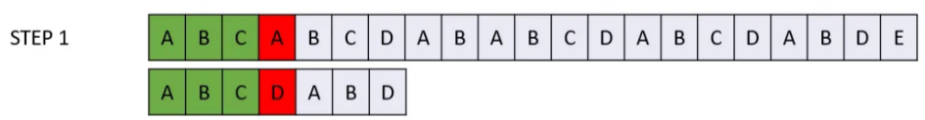
KMP Pattern Matching Algorithm
0 | 1 | 2 | 3 | 4 | 5 | 6
0 | 0 | 0 | 0 | 1 | 2 | 0
A | B | C | D | A | B | D
LPS Table
No of Shift = length(ABC) - 0
= 3 – 0 = 3

Slide 51
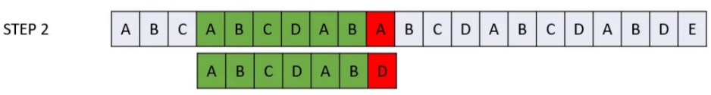
KMP Pattern Matching Algorithm
0 | 1 | 2 | 3 | 4 | 5 | 6
0 | 0 | 0 | 0 | 1 | 2 | 0
A | B | C | D | A | B | D
LPS Table

Slide 52
KMP Pattern Matching Algorithm
0 | 1 | 2 | 3 | 4 | 5 | 6
0 | 0 | 0 | 0 | 1 | 2 | 0
A | B | C | D | A | B | D
LPS Table
No of Shift = length(ABCDAB) - 2
= 6 – 2 = 4

Slide 53
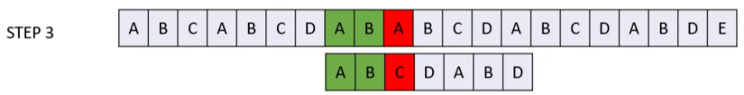
KMP Pattern Matching Algorithm
0 | 1 | 2 | 3 | 4 | 5 | 6
0 | 0 | 0 | 0 | 1 | 2 | 0
A | B | C | D | A | B | D
LPS Table

Slide 54
KMP Pattern Matching Algorithm
0 | 1 | 2 | 3 | 4 | 5 | 6
0 | 0 | 0 | 0 | 1 | 2 | 0
A | B | C | D | A | B | D
LPS Table
No of Shift = length(AB) - 0
= 2 – 0 = 2

Slide 55
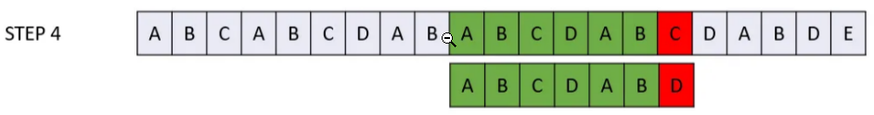
KMP Pattern Matching Algorithm
0 | 1 | 2 | 3 | 4 | 5 | 6
0 | 0 | 0 | 0 | 1 | 2 | 0
A | B | C | D | A | B | D
LPS Table

Slide 56
KMP Pattern Matching Algorithm
0 | 1 | 2 | 3 | 4 | 5 | 6
0 | 0 | 0 | 0 | 1 | 2 | 0
A | B | C | D | A | B | D
LPS Table
No of Shift = length(ABCDAB) - 2
= 6 – 2 = 4

Slide 57
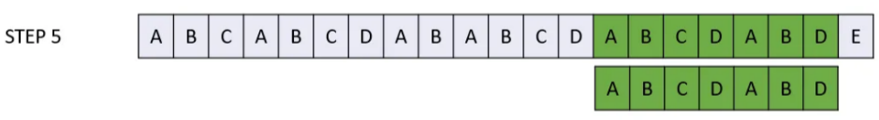
KMP Pattern Matching Algorithm
0 | 1 | 2 | 3 | 4 | 5 | 6
0 | 0 | 0 | 0 | 1 | 2 | 0
A | B | C | D | A | B | D
LPS Table
Pattern Found

Slide 58
KMP Pattern Matching Algorithm
Time Complexity = O( |P| + |T|)
Space Complexity = O( |P| + |T|)

Slide 59
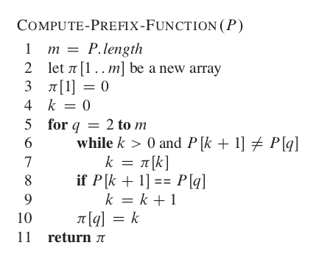
KMP Pattern Matching Algorithm

Slide 60
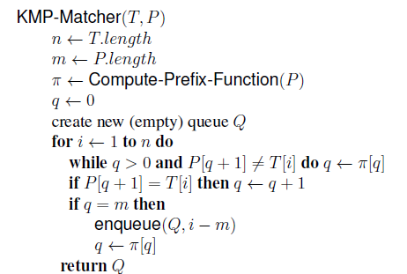
KMP Pattern Matching Algorithm

Slide 61
Lecture:32

Slide 62
NP Completeness

Slide 63
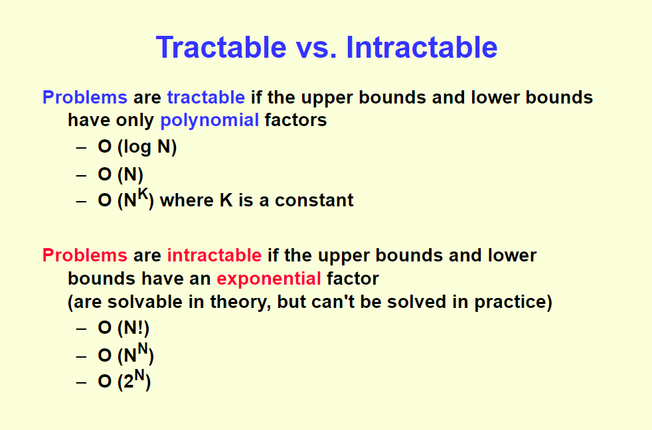

Slide 64
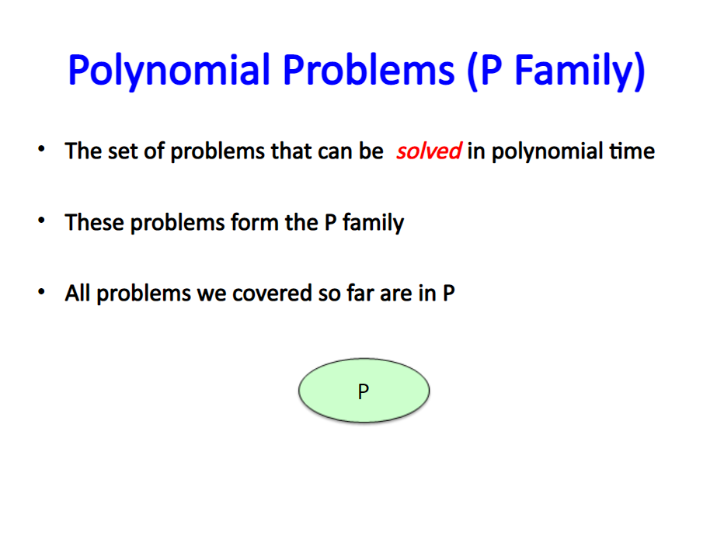

Slide 65
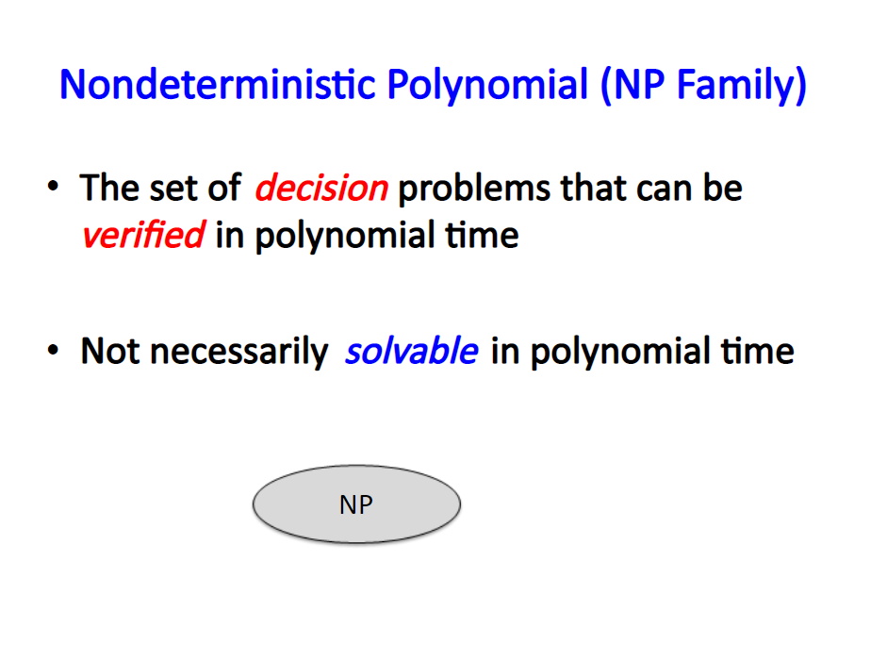

Slide 66
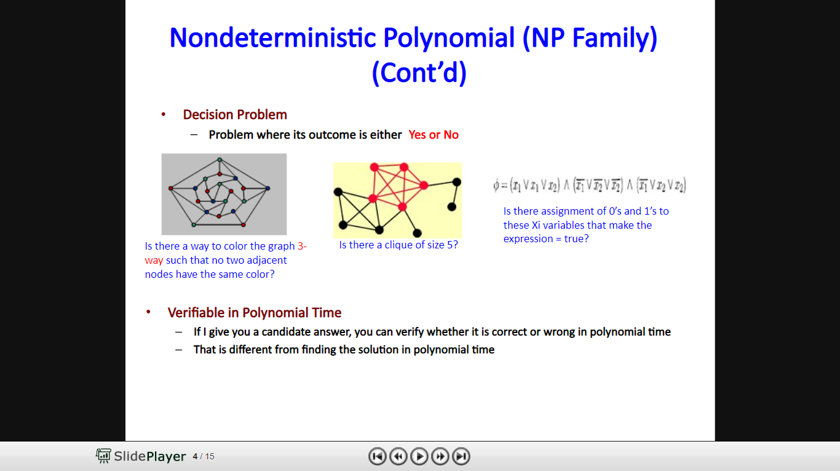

Slide 67
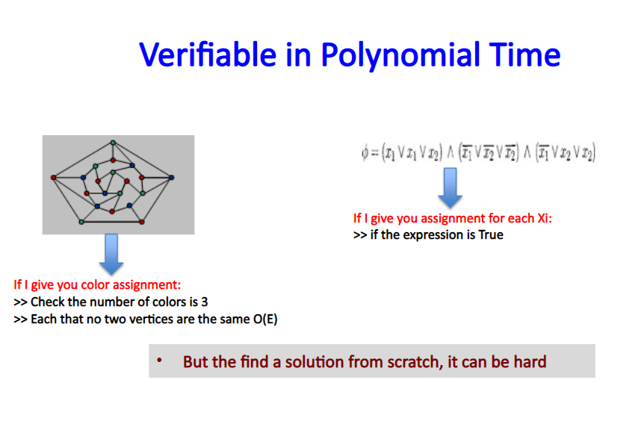

Slide 68
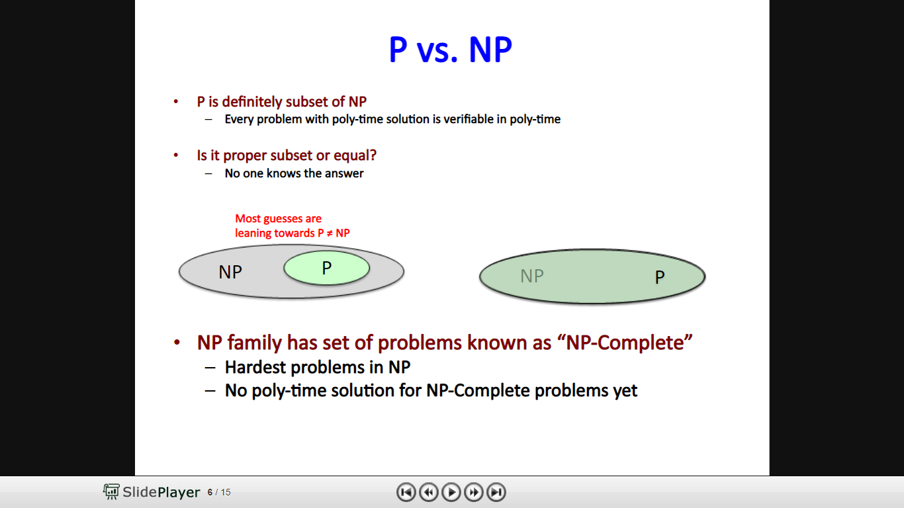

Slide 69
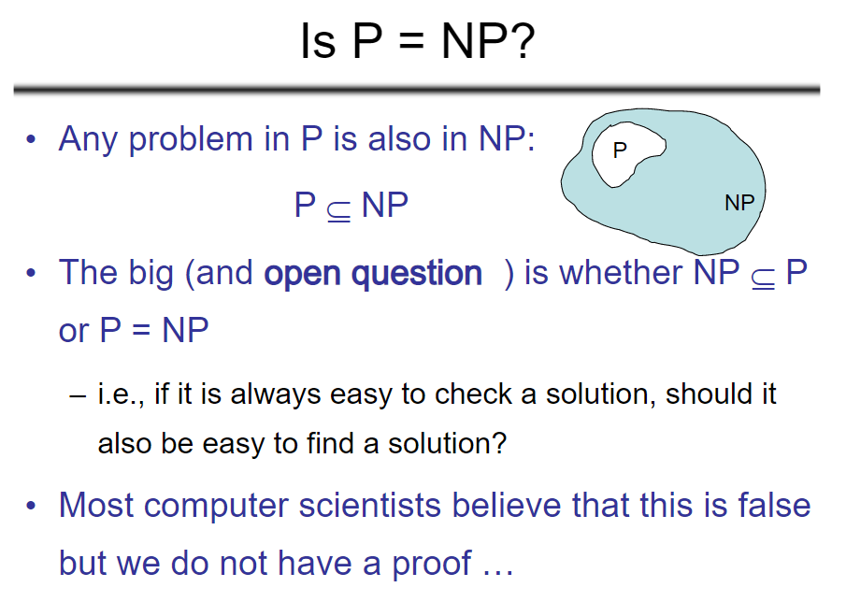

Slide 70
P=NP ?
One of the deepest questions in computer science is called P vs NP, and answering the question would earn you a million dollar prize.
P vs NP is one of the Clay Mathematics Institute Millennium Prize Problems, seven problems judged to be among the most important open questions in mathematics.

Slide 71
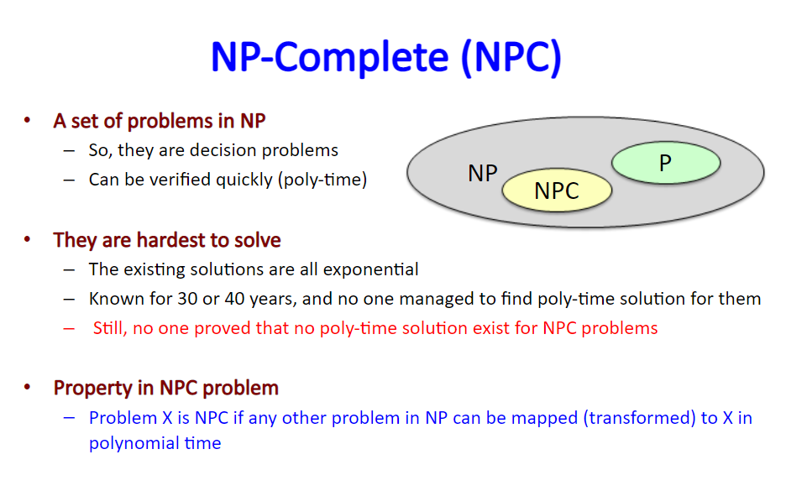

Slide 72
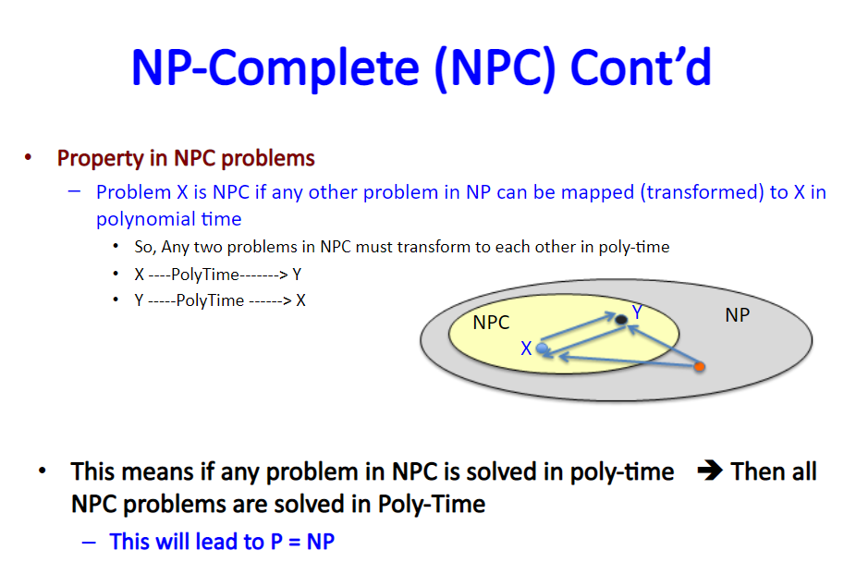

Slide 73
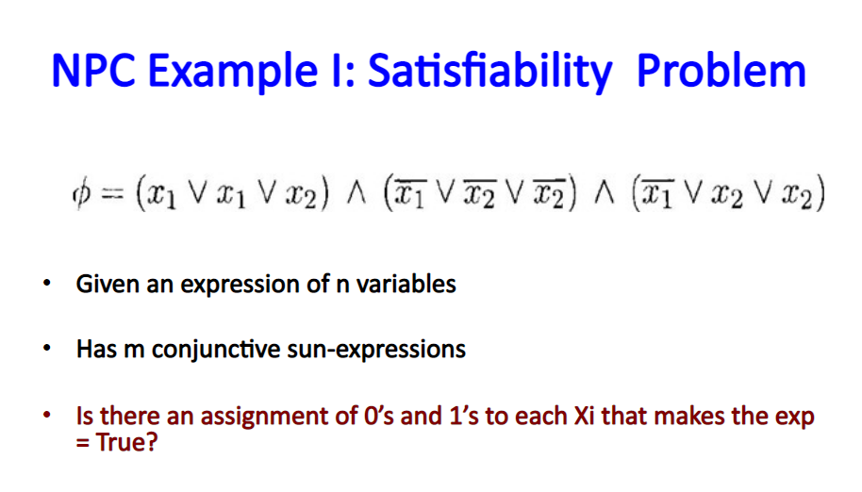

Slide 74
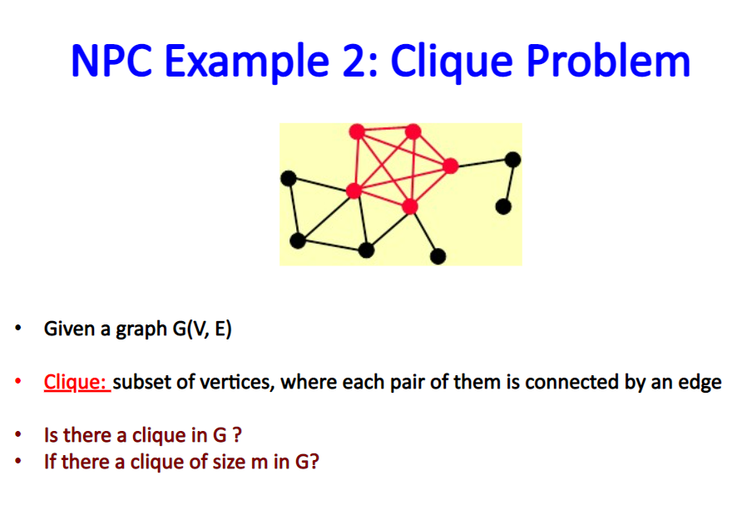

Slide 75
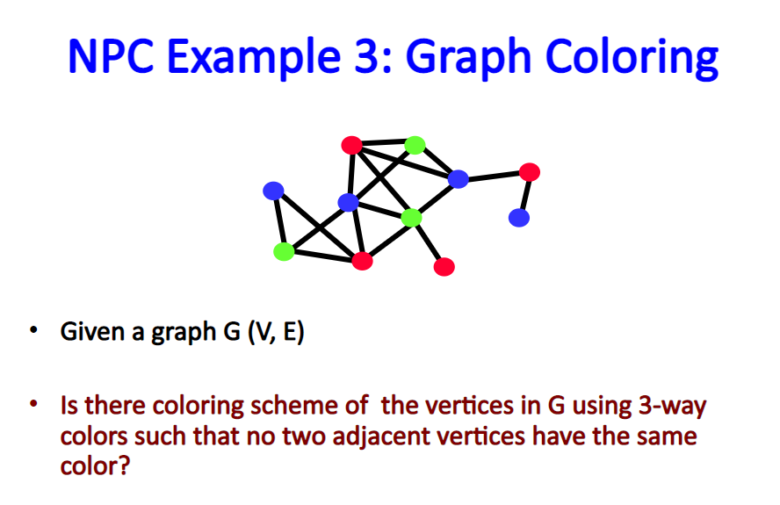

Slide 76
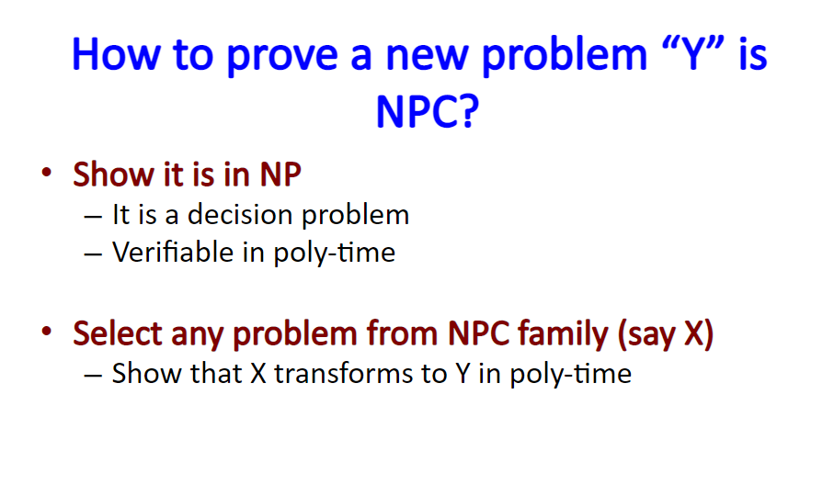

Slide 77
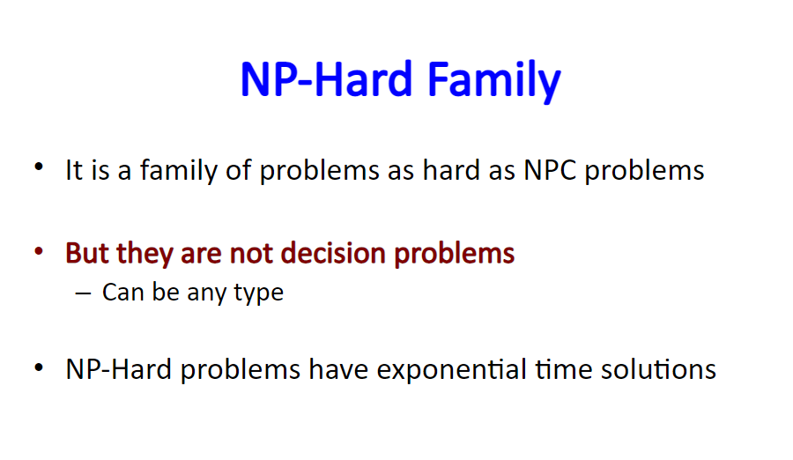

Slide 78
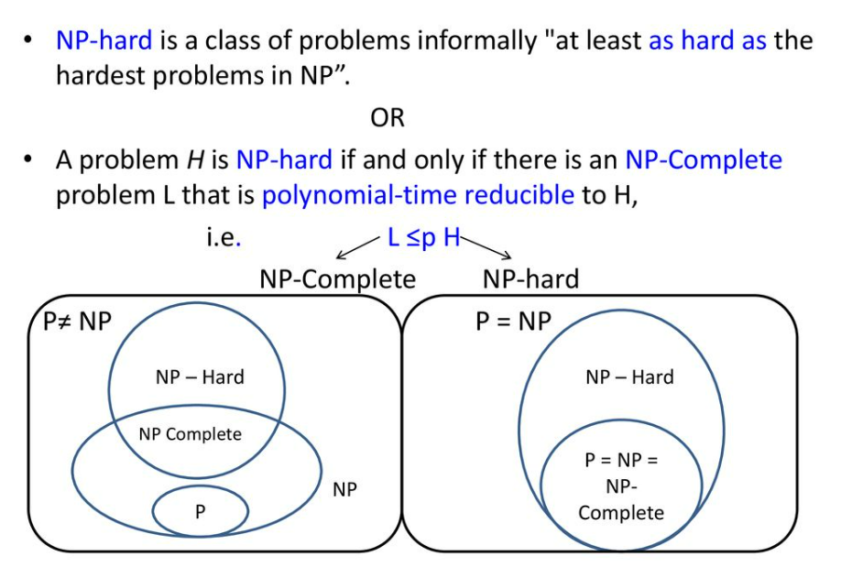

Slide 79
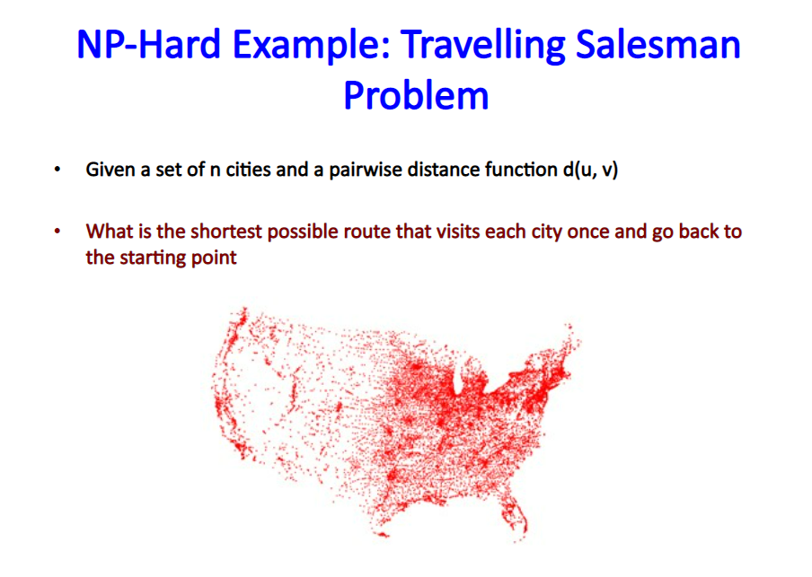

Slide 80
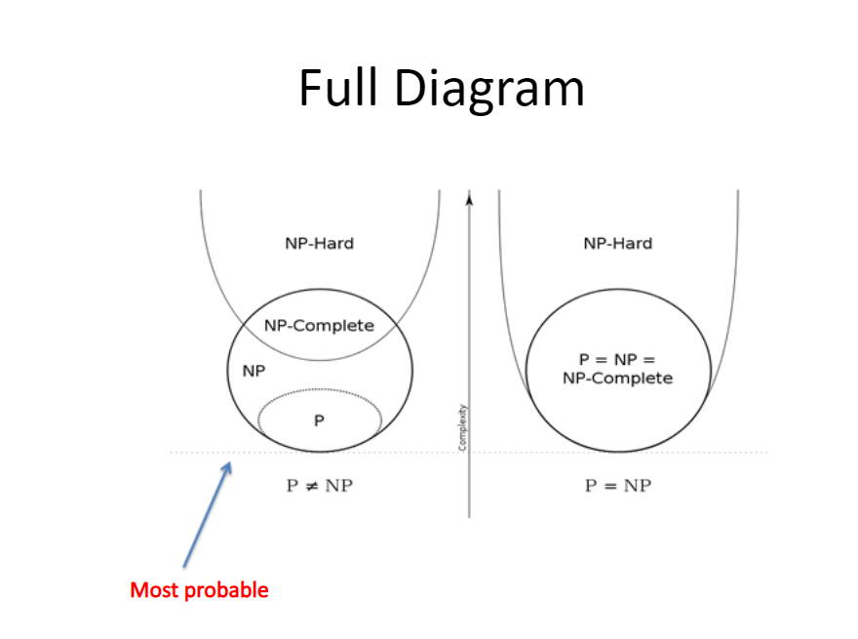

Slide 81
